Slide 1
Module-I
Object Oriented Fundamentals
Vaishali R. Kandekar

Slide 2
Contents
Need of object oriented programming
Features of OOP
Introduction to C++ : structure of C++ program
Built-in & User defined data types
Access Specifiers
Example illustrating creation of classes & objects
Constructors, distructors
Default Arguments
Copy Constructors, Default Constructors
Parameterized Constructors, Destructor

Slide 3
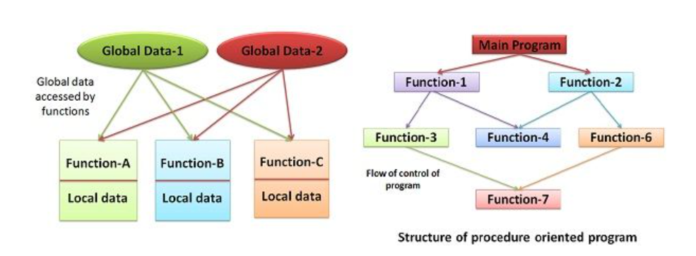
Need of Object Oriented Programming

Slide 4
Procedure Oriented Programming
Emphasis on Functions – The program is divided into functions, which operate on data.
Global Data – Data is shared among functions, making it vulnerable to unintended modifications.
Top-Down Approach – The program is designed using a step-by-step breakdown of tasks.
No Data Hiding – Data is freely accessible and modified by any function.
Difficult to Modify – If data structure changes, many functions need modifications.
Reusability Issues – Functions are not easily reusable for different programs.
Examples: C, FORTRAN, COBOL

Slide 5
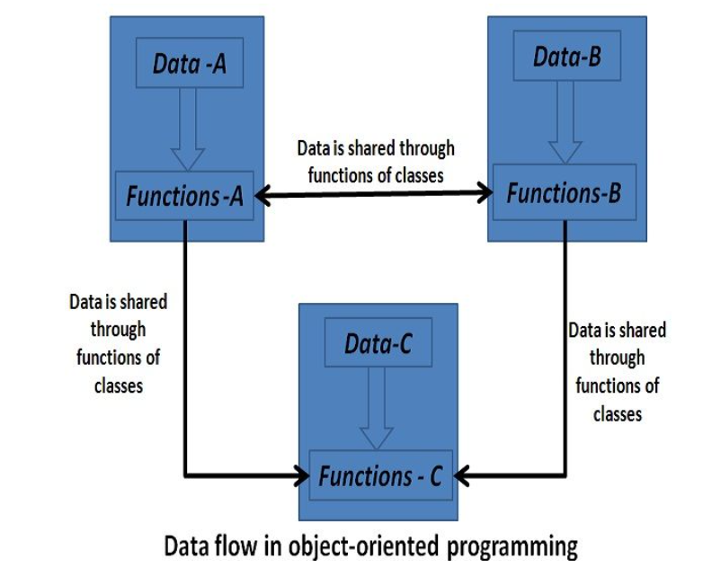
Object Oriented Programming

Slide 6
Object Oriented Programming
Emphasis on Objects – The program is divided into objects containing both data and functions.
Encapsulation – Data is hidden and accessed only through methods, ensuring security.
Bottom-Up Approach – The program is built by defining and linking objects.
Data Abstraction – Only essential information is exposed; implementation details are hidden.
Easy Maintenance – Changes in data structure require minimal modifications.
Code Reusability – Objects and classes can be reused across different programs.
Examples: C++, Java, Python

Slide 7
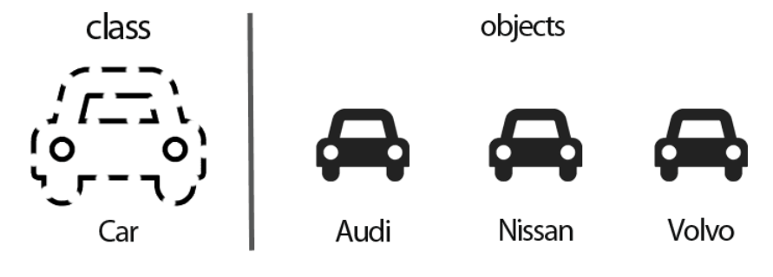
Features of OOP : Objects & Classes
Class: Blueprints for objects Object: real-life entities or a real life instance of class

Slide 8


Features of OOP : Data Abstraction (Simplifying Complexity)
Hiding lower level details & exposing only the essential & relevant details to the users.
A car which abstract the internal details &
expose to the driver only those details that
are relevant to the interaction of the driver
with the Car.
An ATM machine, All are performing
operations on the ATM like cash withdrawal,
money transfer, retrieve mini-statement etc.,
but we can’t know internal details about ATM.

Slide 9

Features of OOP : Encapsulation (Bundling Data and Logic)
Abstract everything you need and encapsulate everything you don’t need.
Encapsulation
Data Hiding
Bundling
Making data members private
Binding data( variables)
Functions into a single unit(Class)

Slide 10
Features of OOP : Encapsulation (Bundling Data and Logic)
Making data members private (Account balance,
PIN, Bank server data are hidden from the user)
and providing public methods to access
them securely.
The engine, fuel injection system, braking mechanism, ECU (Engine Control Unit), and transmission are not directly accessible to the driver.
Public Methods (Controlled Access): The driver interacts with the car through accelerator, brake, clutch, gear, and ignition without directly handling internal components.

Slide 11

Features of OOP : Inheritance
one class can inherit the attributes and functions of another.
This means that the derived class can use all of the base class's members as well as add its own.
Because it reduces the need to duplicate code for comparable classes, inheritance promotes code reusability and maintainability.

Slide 12

Features of OOP : Polymorphism
One object can perform different roles in different situations then it is called polymorphism.
In Shopping malls behave like Customer
In Bus behave like Passenger
In School behaves like Student
At Home behave like Son

Slide 13
Early Binding (Compile-Time Polymorphism)
Also known as Static Binding.
The function to be executed is determined at compile time.
Achieved through Method Overloading or Operator Overloading.
Example: A Calculator with Multiple Add Methods
If you call add(2, 3), it calls the integer addition method.
If you call add(2.5, 3.5), it calls the floating-point addition method.
The decision is made at compile time.

Slide 14
Late Binding (Run-Time Polymorphism)
Also known as Dynamic Binding.
The function to be executed is determined at runtime.
Achieved through Method Overriding in inheritance.
Example: Animal Sounds
If we have a makeSound() function in an Animal class, the sound depends on the actual animal (Dog, Cat, etc.).
The decision is made at runtime, based on the object type.

Slide 15
Message Passing
Message passing is the communication between objects in OOP. One object calls a function on another object, sending a "message."
Example: Ordering Food in a Restaurant
The Customer object calls the orderFood() function on the Waiter object (sending a message).
The Waiter object then calls the prepareFood() function on the Kitchen object.
The Kitchen processes the request and completes the operation.
(class Customer, class Waiter, class Kitchen)

Slide 16
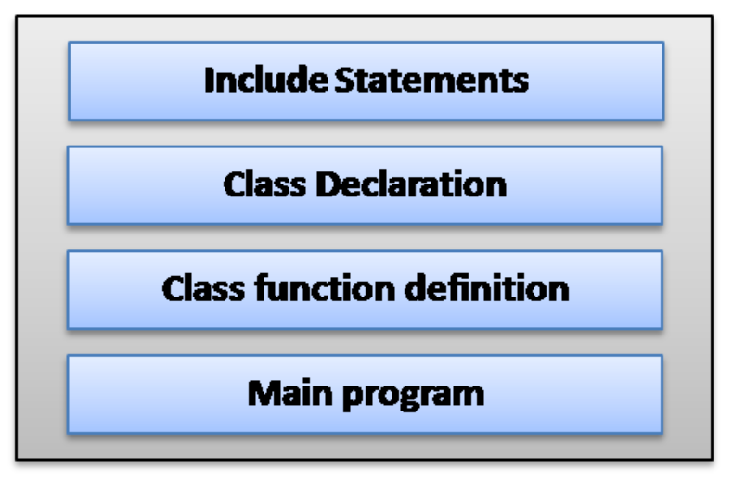
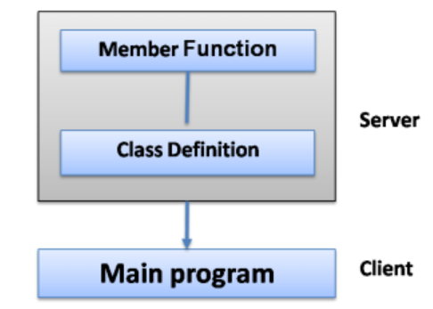
Structure of C++ program
Structure of C++ Program
The Client-Server Model

Slide 17
Class
“A class is a way to bind the data & its associated functions together.”
It allows the data to be hidden, if necessary, from external use.
“A class is like a blueprint or template for creating objects. It defines what properties (variables) and behaviors (functions) an object will have.”
Class Declaration : describes the type and scope of its members
Class function definitions: describe how the class functions are implemented.
The variable declared inside the class are known as data members and functions are known as member functions.
Only the member functions can have access to the private data members and private functions.
However the public members (both functions and data) can be accessed from outside the class.

Slide 18
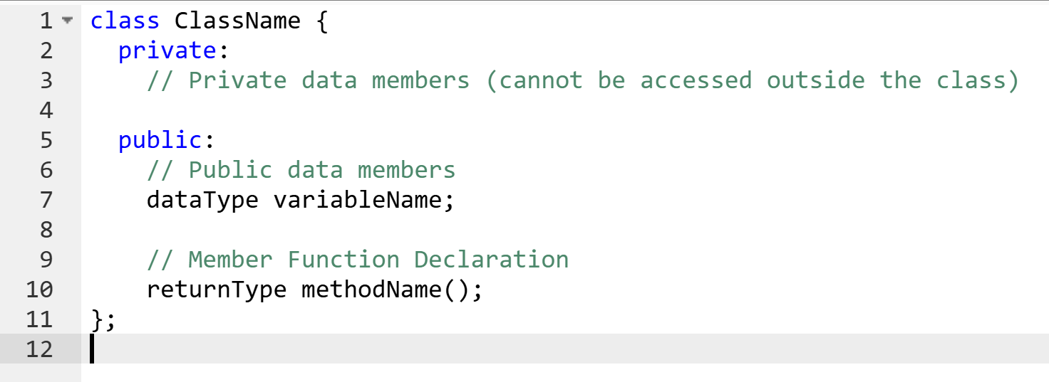
Class Syntax

Slide 19
Class Example
Think of a car blueprint. It defines:
Properties: color, engine type, number of wheels
Behaviors: start(), stop(), accelerate()
But you cannot drive a blueprint—you need a real car!

Slide 20
Object
An object is a real-world instance of a class.
Using the car blueprint, we can create real cars:
A red Ferrari
A blue Tesla
Each car follows the blueprint but has its own values.

Slide 21
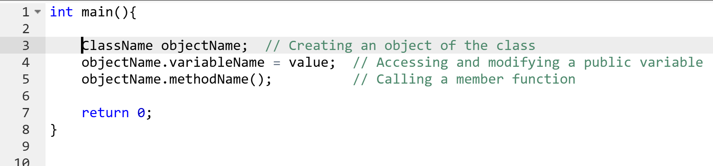
Object Creation Syntax
Dot (.) operator is used to create object.

Slide 22
Accessing Class Members
Class members (variables and functions) can be accessed using objects and the dot (.) operator.
A private data of the class can be accessed only through the member functions of that class.
A variable declared as public can be accessed by the objects directly.
Note: the use of data in this manner defeats the very idea of data hiding & therefore should be avoided.

Slide 23
Defining Member Functions
Outside the class definition:
Using Scope Resolution ::
we define functions outside the class to keep the class clean and readable.
Inside the class definition :
If we define a function inside the class, it is automatically treated as inline (small and fast).

Slide 24
What is an Inline Function?
When a function is defined inside a class, it is automatically treated as an inline function by the compiler.
Instead of making a function call (which takes time), the compiler directly replaces the function code at the place where it is called.
This can make execution faster but increases code size (because the function gets copied multiple times).

Slide 25
Brain teaser
Create an object for a book and display its details like title, author, price
Create a Bank Account, deposit ₹5000, withdraw ₹2000, and display the final balance.
display the area of the rectangle.
Create a car object with brand, model, year and display the details.

Slide 26
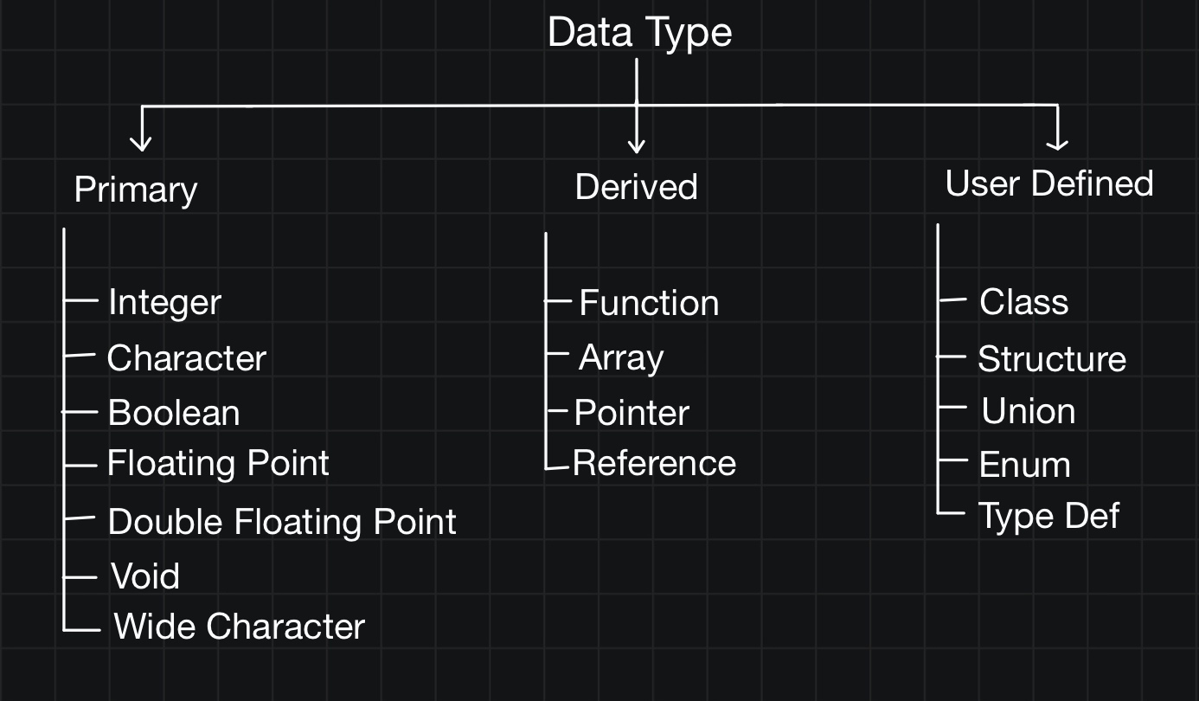

Slide 27
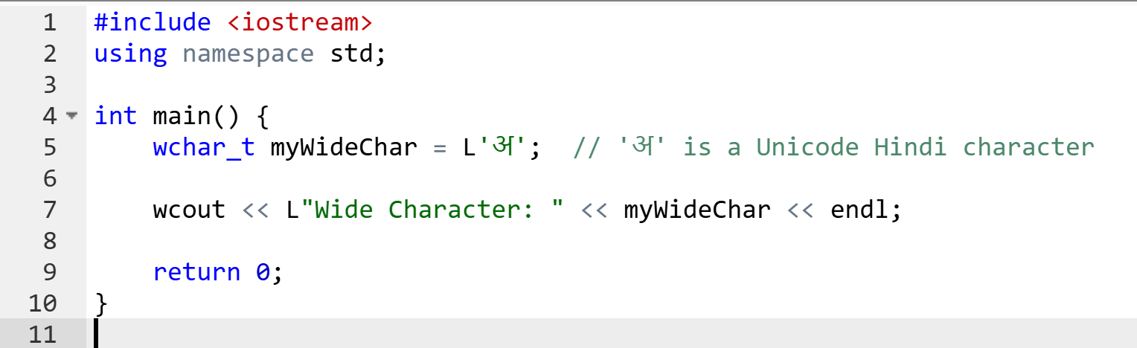
wchar_t (wide character type)
It is used for internationalization and multilingual applications.
It typically takes 2 or 4 bytes, depending on the system.
It is used with wcout for wide character output.
L'अ' is a wide character literal (L before the character indicates it is a wide character).
wcout is used instead of cout to print wide characters.

Slide 28
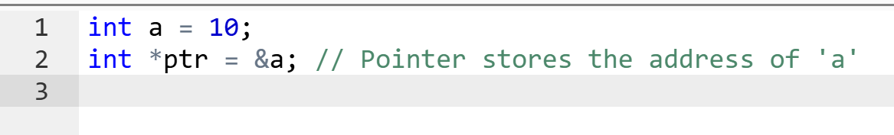
Pointers
A pointer is a variable that stores the memory address of another variable.
Use the * (asterisk) to declare a pointer.
Use the & (address-of operator) to get the memory address.
Use *ptr (dereferencing) to access the value at that address.

Slide 29
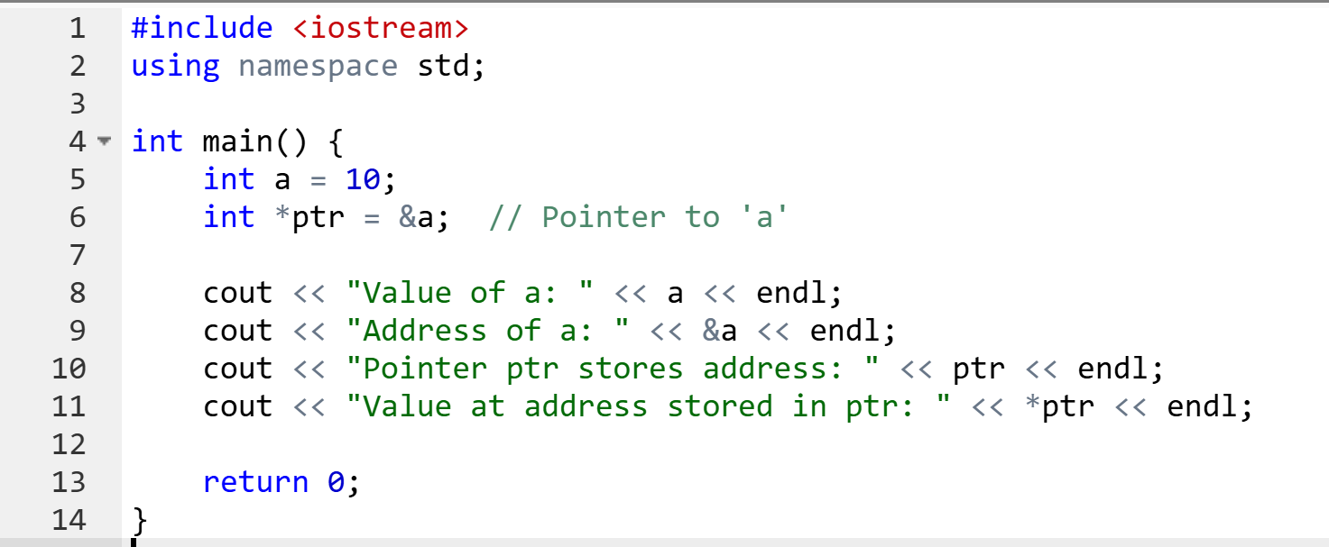
Pointers
Pointer Operations:
Pointer Arithmetic: ptr + 1 moves the pointer to the next memory location.
Null Pointer: int *p = nullptr; (points to nothing)
Dynamic Memory Allocation: int *p = new int; (allocates memory).

Slide 30
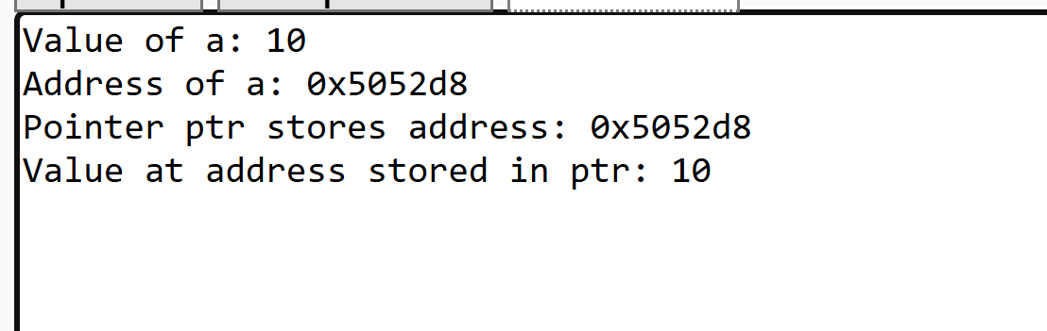
Pointers

Slide 31
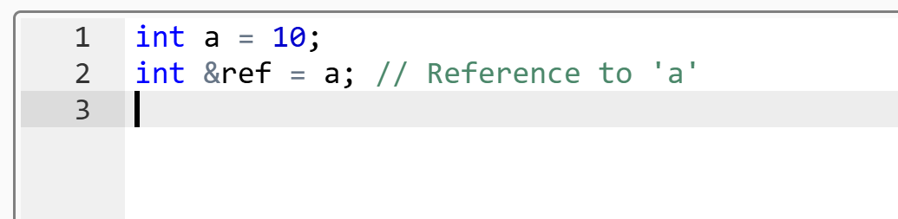
References
A reference is an alias (another name) for an existing variable.
Declared with &, but it is not a pointer.
Must be initialized when declared.
Cannot be reassigned to another variable.

Slide 32
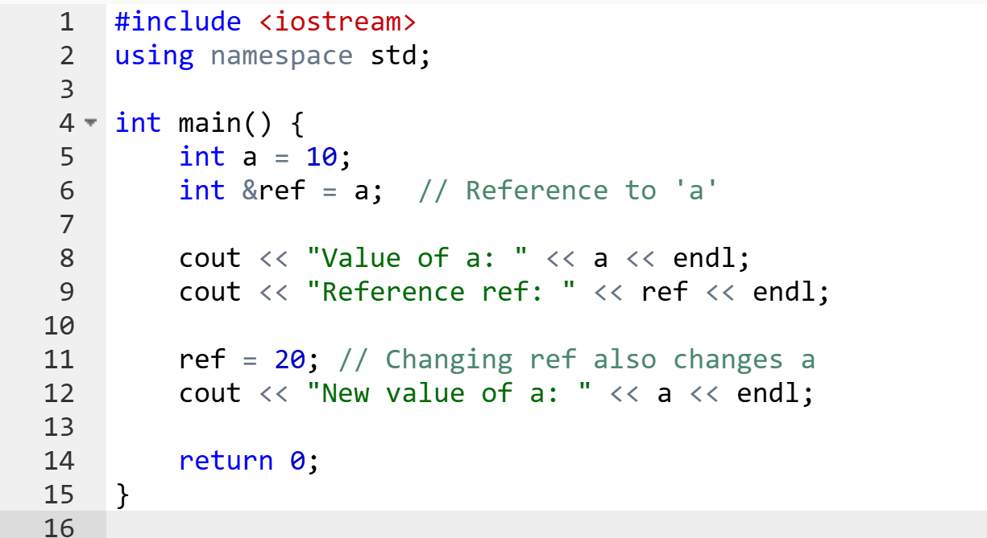
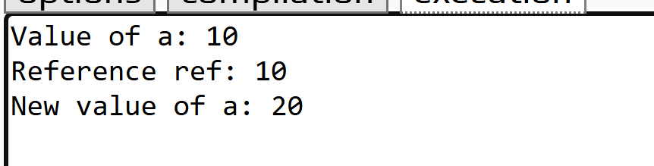
References

Slide 33
Pointers & References
Feature | Pointers | References
Can store address? | Yes | No (just an alias)
Can be reassigned? | Yes | No (must be initialized)
Null value? | Can be nullptr | No null references
Memory access | Indirect (dereferencing) | Direct (alias to variable)
Used for dynamic memory? | Yes (new/delete) | No

Slide 34
Access Specifiers
Control the visibility and accessibility of class members (variables and functions)
private – Members are accessible only within the same class.
protected – Members are accessible within the same class and derived (child) classes.
public – Members are accessible from anywhere.

Slide 35
Constructor
A constructor is a special member function in a class that gets automatically called when an object is created.
It is used to initialize objects.
Characteristics of Constructors
The constructor name must be the same as the class name.
It has no return type (not even void).
It is invoked automatically when an object is created.
Can be overloaded (multiple constructors in the same class).
If no constructor is defined, the compiler provides a default constructor.

Slide 36
Types of Constructors in C++
Default Constructor – No parameters.
Parameterized Constructor – Accepts arguments.
Copy Constructor – Copies values from another object.
Destructor – Called when an object is destroyed.

Slide 37
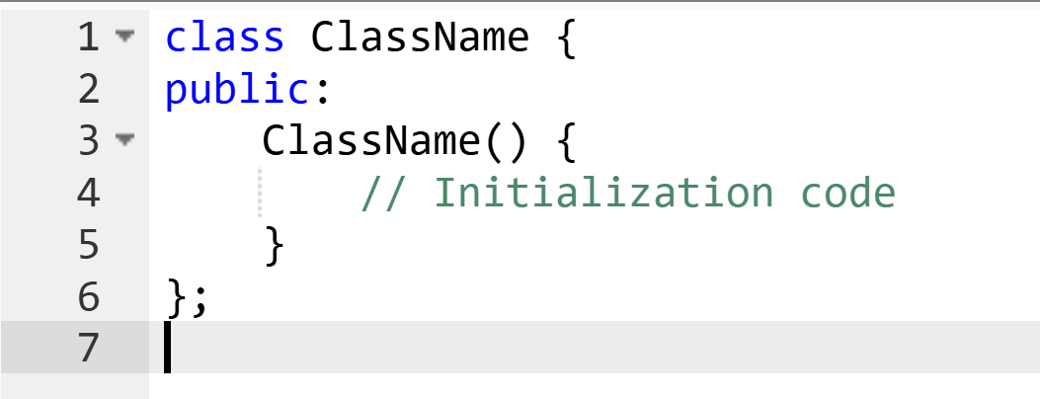
Default Constructor – No parameters.
A default constructor is a constructor with no parameters.
It is automatically called when an object is created.

Slide 38
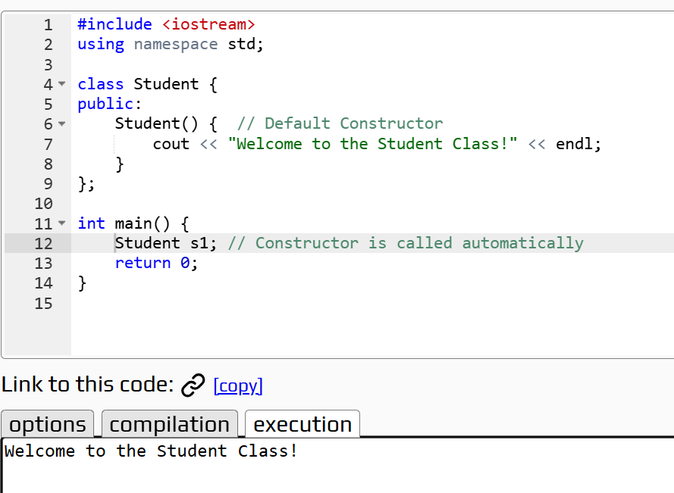
Default Constructor - eg.
A default constructor does not take any arguments.
It is used to initialize objects with default values.
It is invoked automatically when an object is created.

Slide 39
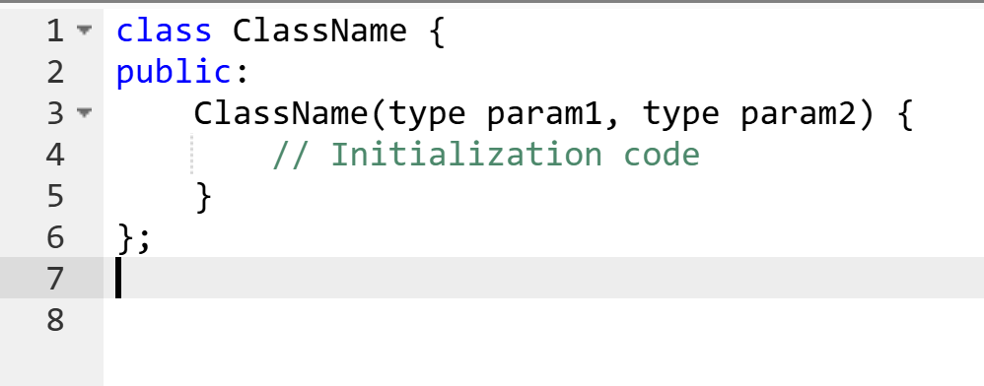
Parameterized Constructor – Accepts arguments.
A parameterized constructor allows passing arguments to initialize object values.

Slide 40
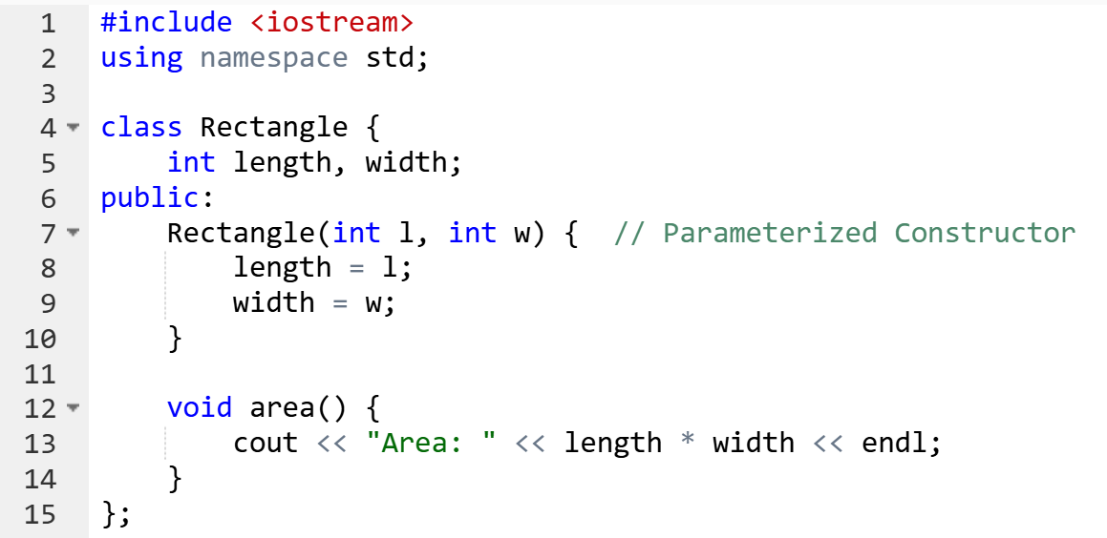
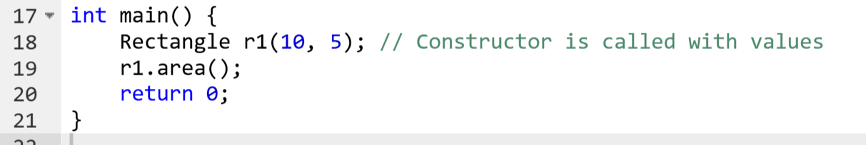
Parameterized Constructor- eg.
A parameterized constructor takes arguments to initialize object data.
It helps in dynamic initialization (different objects with different values).
It is invoked automatically when an object is created.

Slide 41
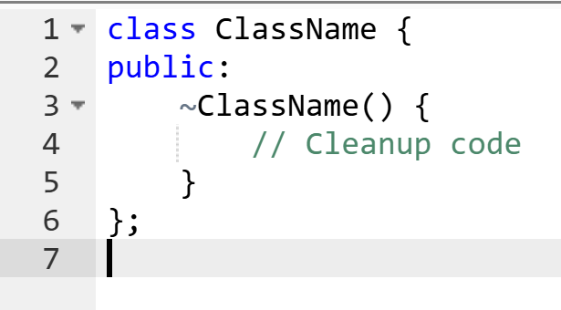
Destructor
A destructor is a special member function that is automatically called when an object is destroyed.
A destructor has the same name as the class but is prefixed with ~
It frees resources
allocated by the object
before destruction.
It is called automatically
when an object goes out
of scope.

Slide 42
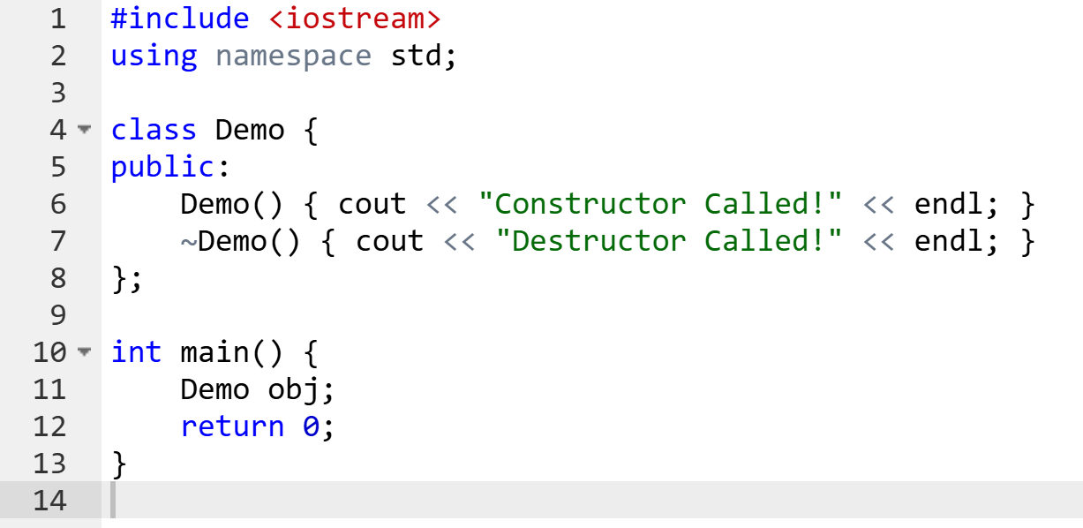
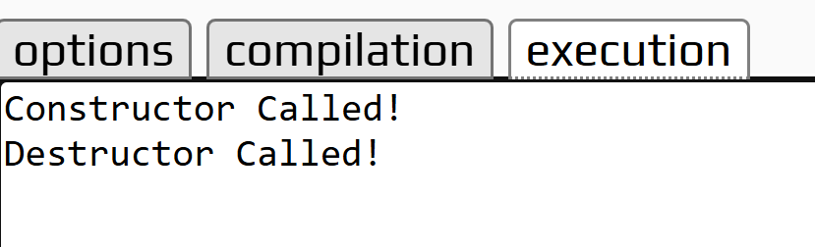
Destructor - eg.

Slide 43
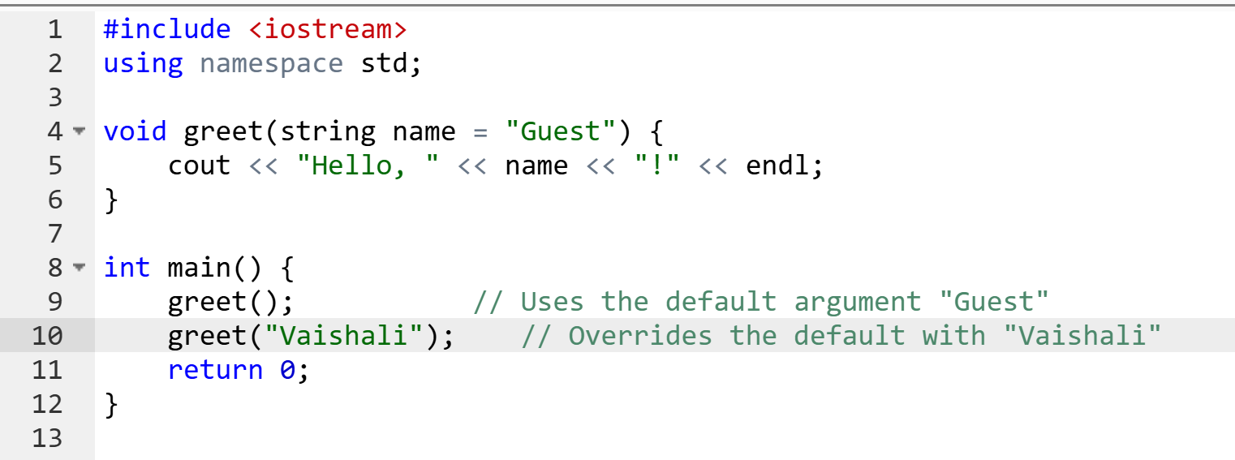
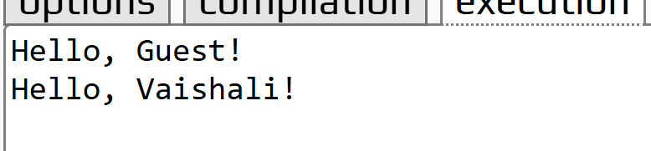
Default Arguments
Default arguments are values provided in a function declaration that are automatically used if no corresponding argument is passed during a function call.
This helps simplify function calls when most parameters have common values.

Slide 44
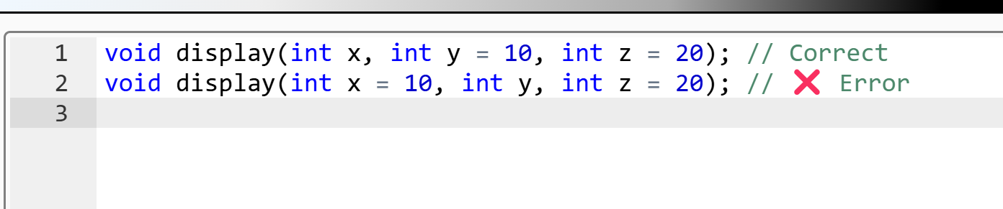
Rules for Default Arguments
Right to Left Rule: Default values should be provided from rightmost parameters
Specified Only Once: Default values can only be provided either in the function declaration or definition, not both.
Simplifying function calls with commonly used values.
Reducing function overloading.

Slide 45
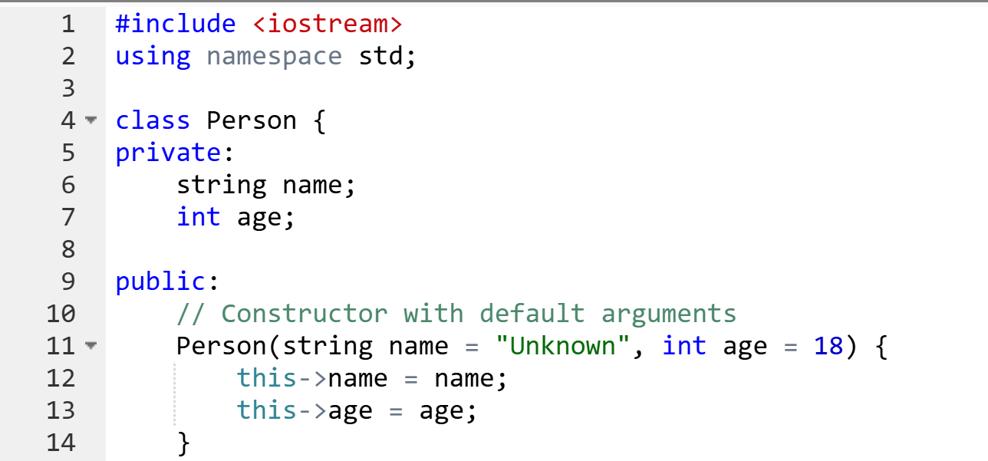
Default Arguments with Constructor
default arguments in constructors to simplify object creation.
A constructor with default arguments allows you to create objects with fewer arguments or even no arguments while still initializing member variables to specific values.

Slide 46
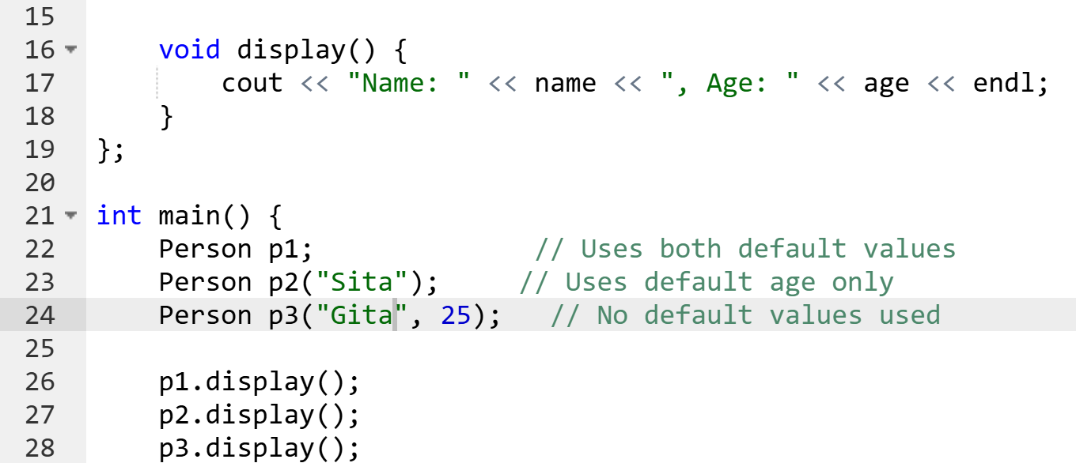
Default Arguments with Constructor

Slide 47
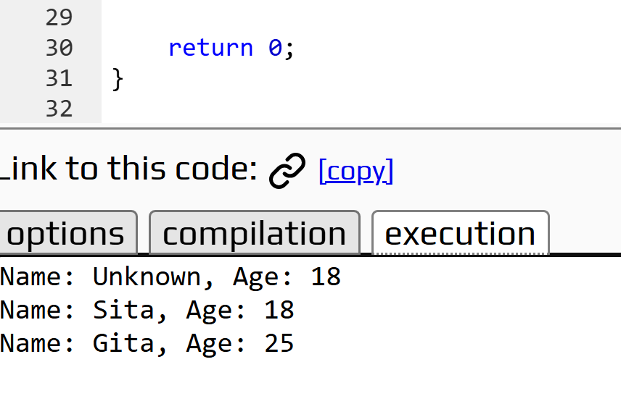
Default Arguments with Constructor
Advantages of Default Arguments in Constructors:
Simplifies object creation with fewer parameters.
Reduces the need for multiple overloaded constructors.
Makes code more readable and maintainable.

Slide 48
Copy Constructor
A special constructor in C++ used to create a new object as a copy of an existing object.
It initializes a new object with the values of an existing object.
When is it called?
When a new object is created from an existing object.
When an object is passed by value to a function.
When an object is returned by value from a function.
Types of Copy:
Shallow Copy: Copies only values (default behavior in C++).
Deep Copy: Manually copies all data, including dynamically allocated memory.

Slide 49
Copy Constructor
Why is it Important?
Ensures proper copying of data.
Prevents memory issues when dealing with dynamic memory.
Real-life Example:
Copying a document on your computer → You have two separate files

Slide 50
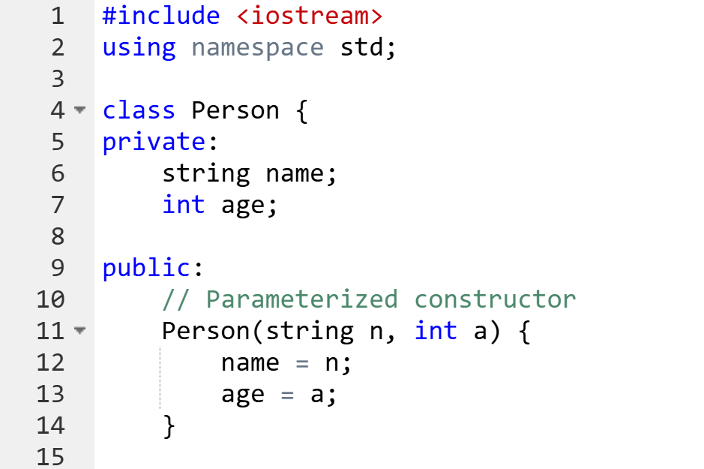
Copy Constructor

Slide 51
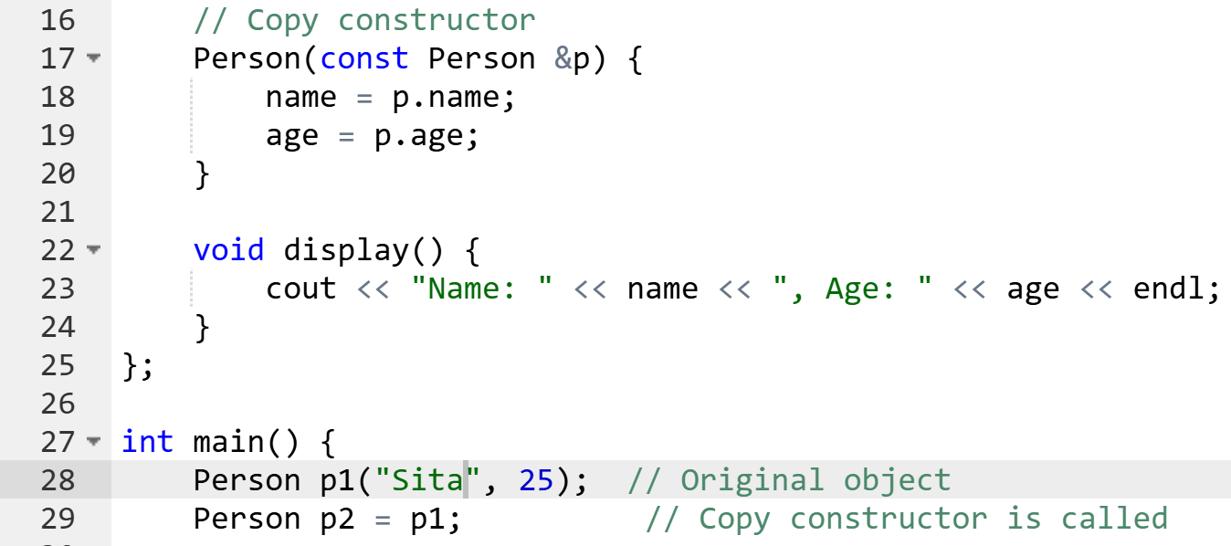
Copy Constructor

Slide 52
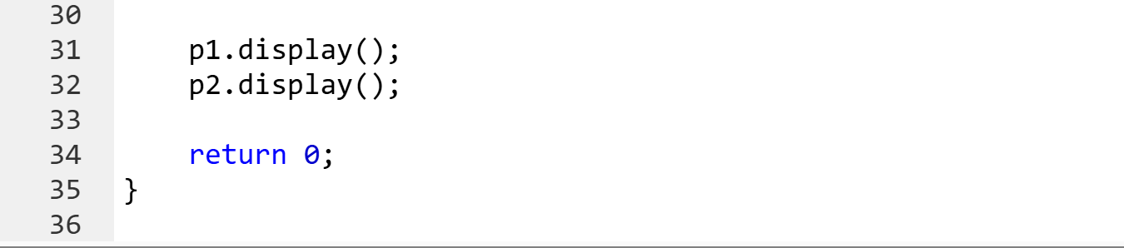
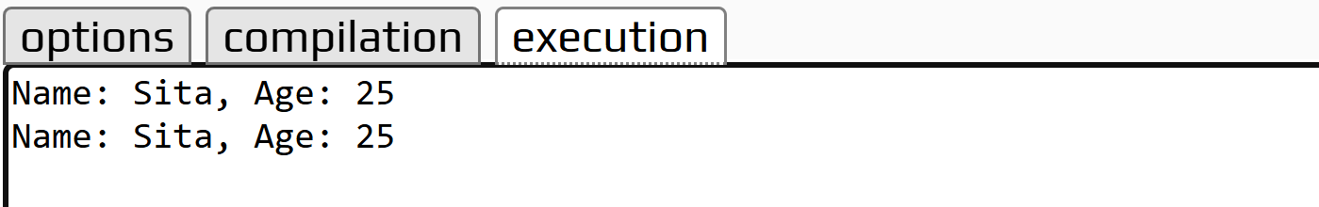
Copy Constructor

Slide 53
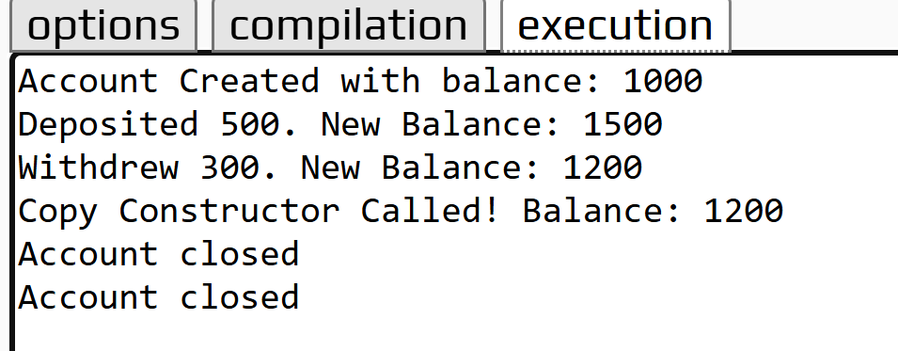
Brain teaser
📌 Problem: Bank Account Simulation:- Create a class BankAccount with:
A default constructor setting balance to 0.
A parameterized constructor that sets an initial balance.
A method deposit() and withdraw() to modify balance.
A copy constructor that transfers balance from one account to another.
A destructor that prints "Account closed" when the object is deleted.

